Slide 1
Chapter 24. Congestion Control and Quality of Service
23.1 Data Traffic
23.2 Congestion
23.3 Congestion Control
23.4 Two Examples
23.5 Quality of Service
23.6 Techniques to Improve QoS
23.7 Integrated Services
23.8 Differentiated Services
23.9 QoS in Switched Networks

Slide 2
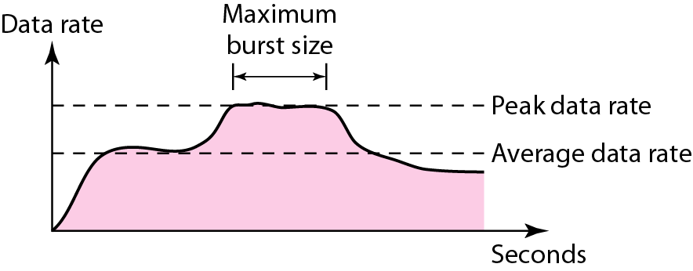
Traffic Descriptors
Traffic descriptor are qualitative values that represent a data flow
Average data rate = amount of data/time
Peak data rate: the max. data rate of the traffic
Max. burst size: the max. length of time the traffic is generated at the peak rate
Effective bandwidth: bandwidth that the network needs to allocate for traffic flow

Slide 3
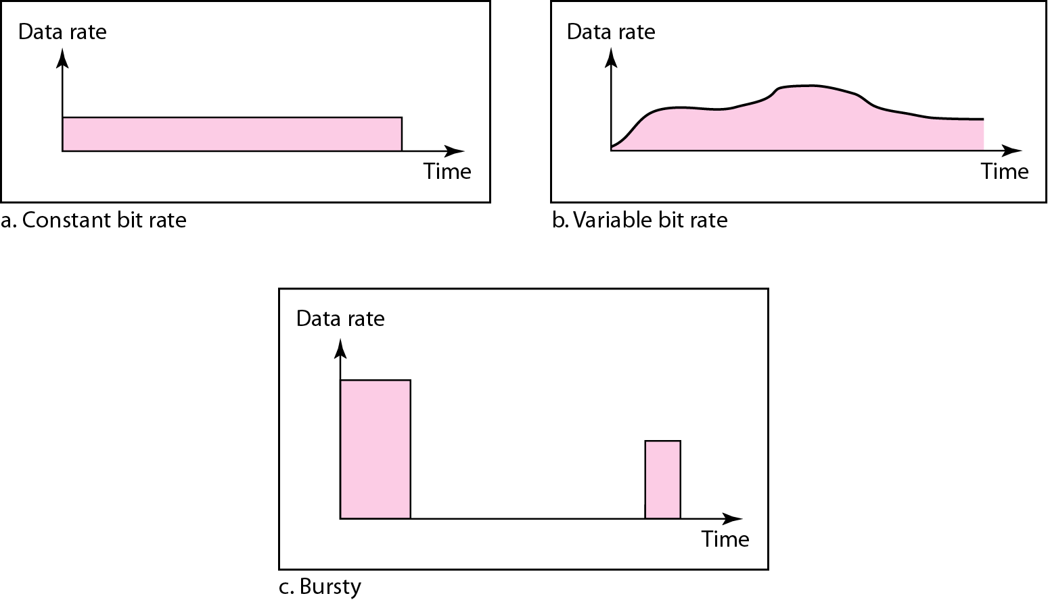
Traffic Profiles
Constant-bit-rate (CBR)
Variable-bit-rate (VBR)
Bursty

Slide 4
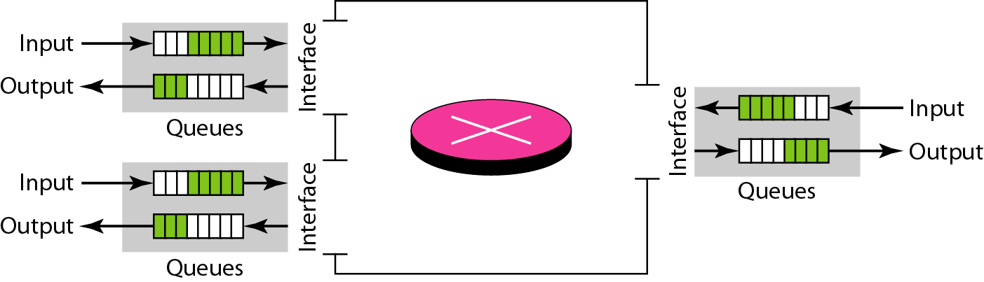
Congestion
Congestion: the load on the network is greater than the capacity of the network
Congestion control: the mechanisms to control the congestion and keep the load below the capacity
Congestion occurs because routers and switches have queues- buffers that hold the packets before and after processing
The rate of packet arrival > packet processing time → input queue longer
The packet departure time < packet processing time → output queue longer

Slide 5
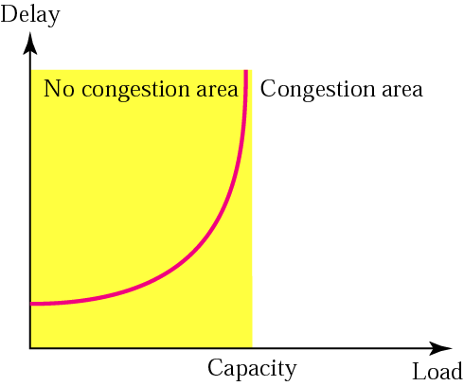
Network Performance-1
Packet delay versus network load
Delay id composed of propagation delay and processing delay

Slide 6
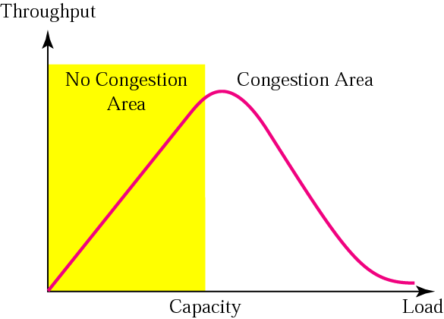
Network Performance-2
Throughput versus network load
Throughput: the number of packets passing through the network in a unit of time

Slide 7
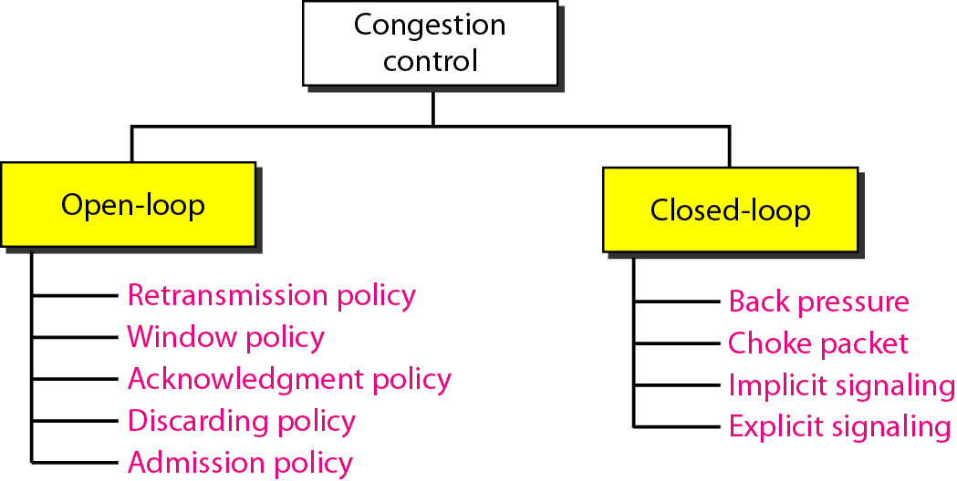
Congestion Control
Congestion control refers to techniques and mechanisms that can either prevent congestion, before it happens, or remove congestion, after it has happened.
Two broad categories: open-loop congestion control (prevention) and closed-loop congestion control (removal).

Slide 8
Open Loop Control: Prevention
Retransmission policy and timers must to be designed to optimize efficiency and at the same time prevent congestion
Window policy: Selective Repeat is better than Go-back-N
Acknowledgement policy: does not ACK every packet
Discard policy: prevent congestion and at the same time may not harm the integrity of the transmission
Admission policy: Switch first check the resource requirement of a flow before admitting it to the network

Slide 9
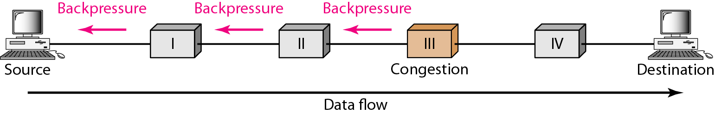
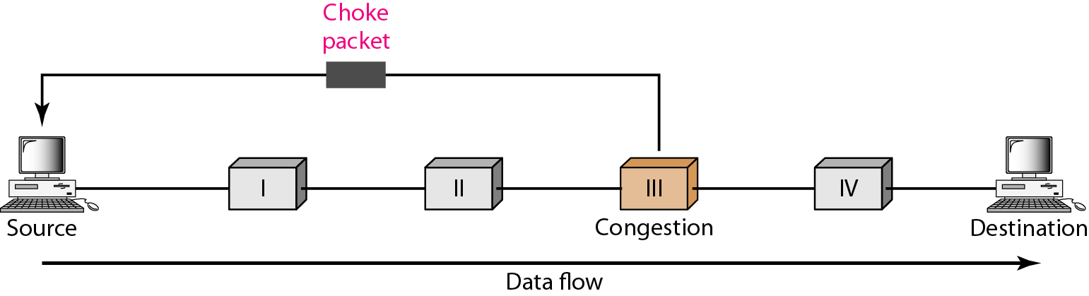
Closed-Loop Congestion Control: Removal
Back pressure: inform the previous upstream router to reduce the rate of outgoing packets if congested
Choke point: a packet sent by a router to the source to inform it of congestion, similar to ICMP’s source quench packet
Implicit signaling: slow down its sending rate by detecting an implicit signal concerning congestion
Explicit signaling: Backward signaling / Forward signaling

Slide 10
Congestion Control in TCP
TCP assumes that the cause of a lost segment is due to congestion in the network.
If the cause of the lost segment is congestion, retransmission of the segment does not remove the cause—it aggravates it.
The sender has two pieces of information: the receiver-advertised window size and the congestion window size
TCP Congestion window
Actual window size = minimum (rwnd, cwnd)
(where rwnd = receiver window size, cwnd = congestion window size)

Slide 11
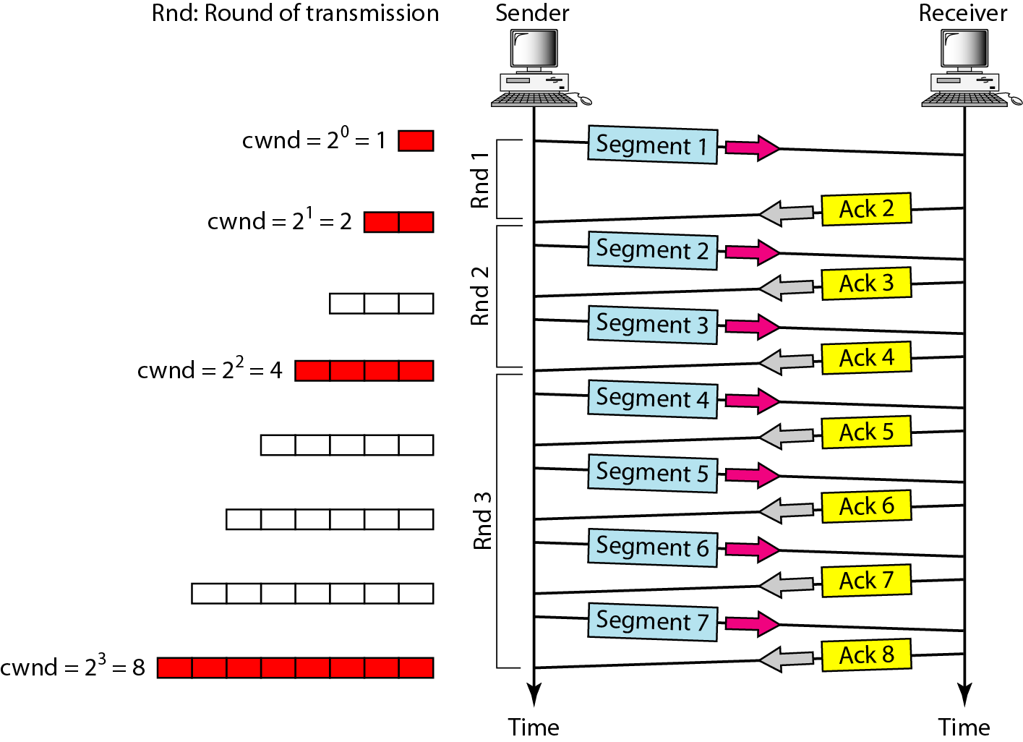
TCP Congestion Policy
Based on three phases: slow start, congestion avoidance, and congestion detection
Slow Start: Exponential Increase
In the slow-start algorithm, the size of the congestion window increases exponentially until it reaches a threshold

Slide 12
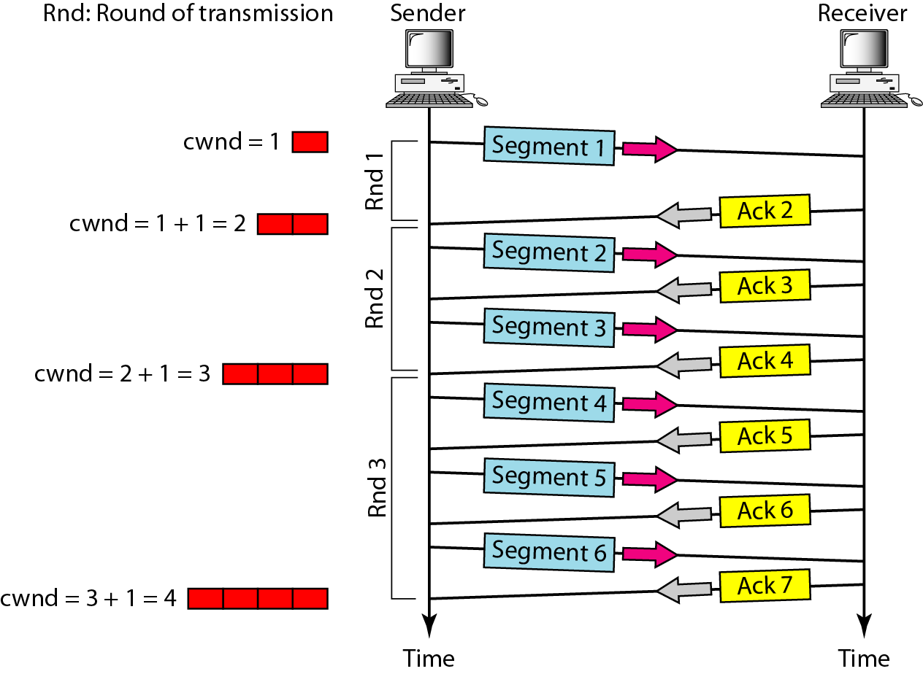
TCP Congestion Policy
Congestion Avoidance: Additive Increase
The size of the congestion window increases additively until congestion is detected

Slide 13
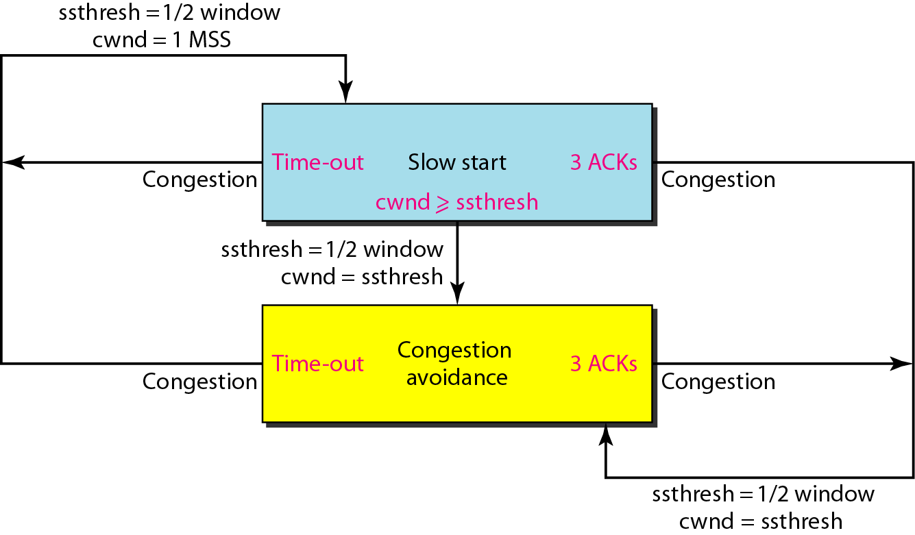
TCP Congestion Policy
Congestion Detection: Multiplicative Decrease
An implementation reacts to congestion detection in one of two ways:
If detection is by time-out, a new slow start phase starts
If detection is by three ACKs, a new congestion avoidance phase starts
Summary

Slide 14
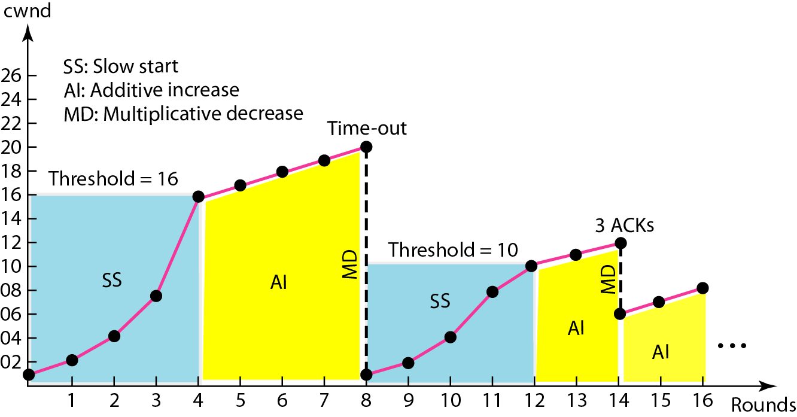
Congestion Example

Slide 15
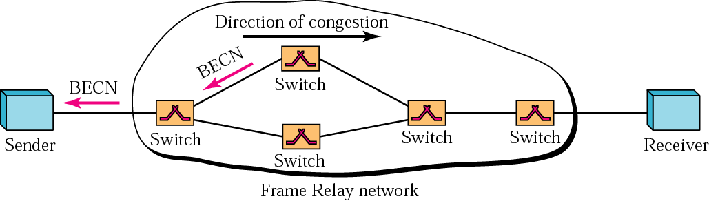
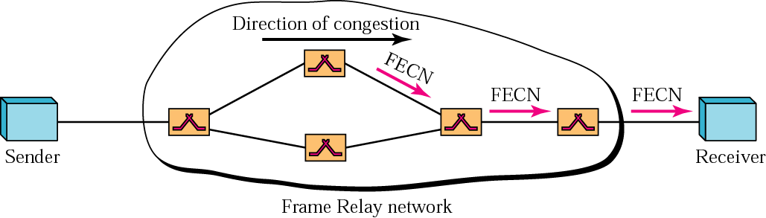
Congestion Control: Frame Relay
Congestion avoidance: BECN and FECN
Backward explicit congestion notification (BECN)
Forward explicit congestion notification (FECN)

Slide 16
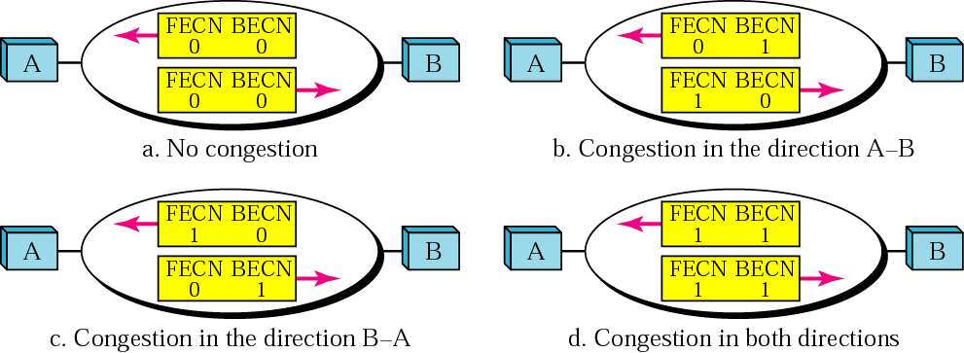
Four Cases of Congestion

Slide 17
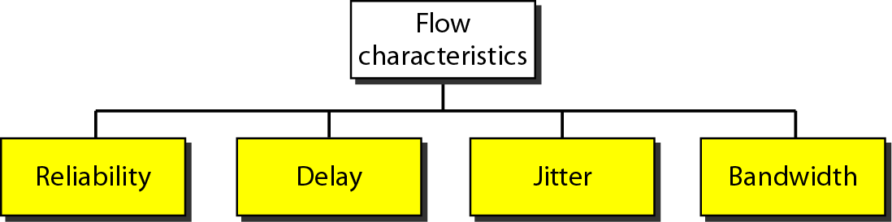
Quality of Service (QoS)
Flow Characteristics:
Reliability
Delay
Jitter: the variation in delay for packets belonging to the same flow
Bandwidth
Flow Classes:
Based on the characteristics, we can classify flows into groups, with each group having similar levels of characteristics

Slide 18
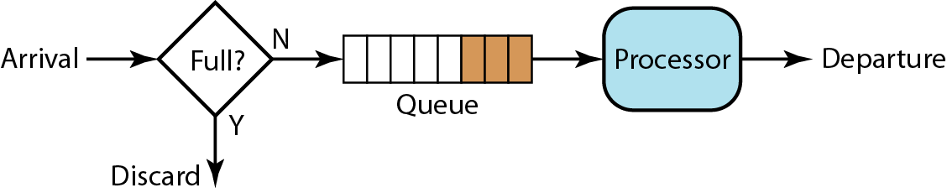
QoS Techniques
Scheduling: FIFO queuing, priority queuing, and weighted fair queuing
Traffic shaping: Leaky bucket, token bucket
Resource reservation
Admission control: accept or reject a flow based on predefined parameters called flow specification
FIFO queuing

Slide 19
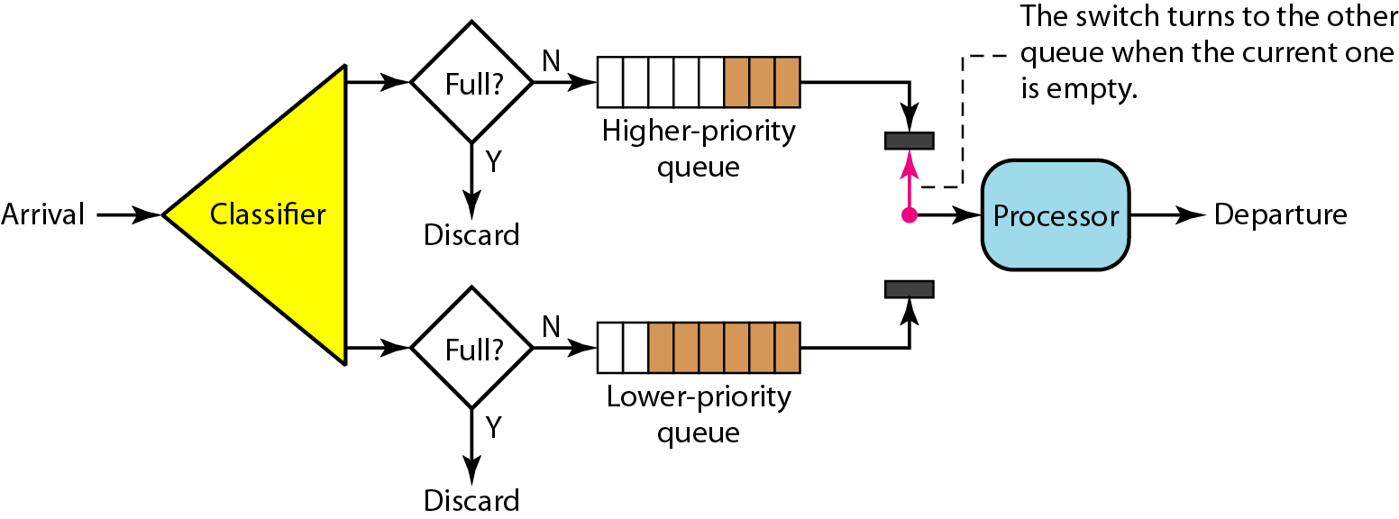
Priority Queuing
Packets are first assigned to priority class. Each priority class has its own queue
The packets in the highest-priority queue are processed first

Slide 20
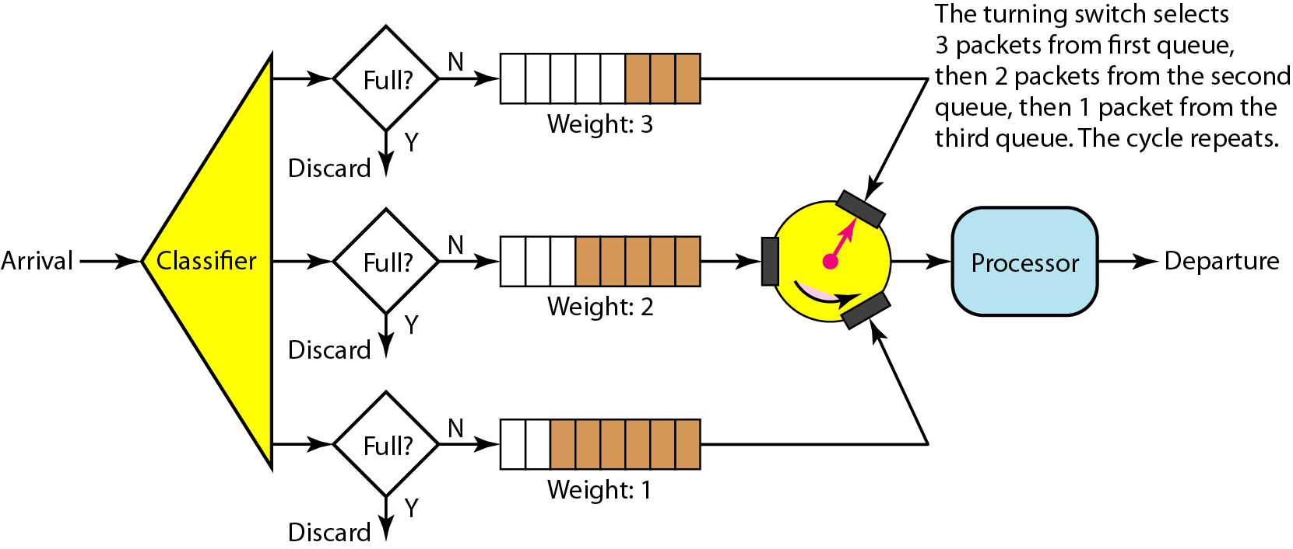
Weighted Fair Queuing
The queues are weighted based on the priority of the queues
The system processes packets in each queue in a round-robin fashion with the number of packets selected from each queue based on the weight

Slide 21
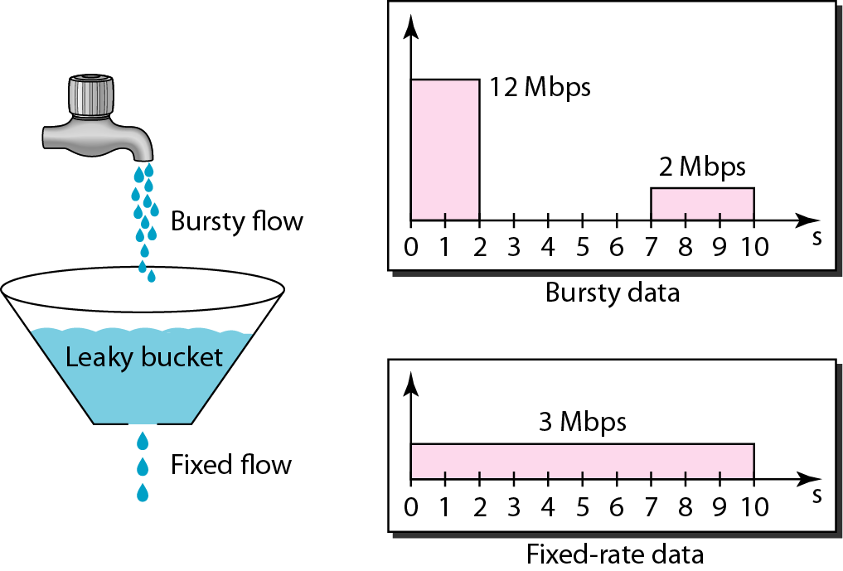
Traffic Shaping: Leaky Bucket
Traffic shaping: to control the amount and the rate of the traffic sent to network
Two techniques: leaky bucket and token bucket
A leaky bucket algorithm shapes bursty traffic into fixed-rate traffic by averaging the data rate. It may drop the packets if the bucket is full.

Slide 22
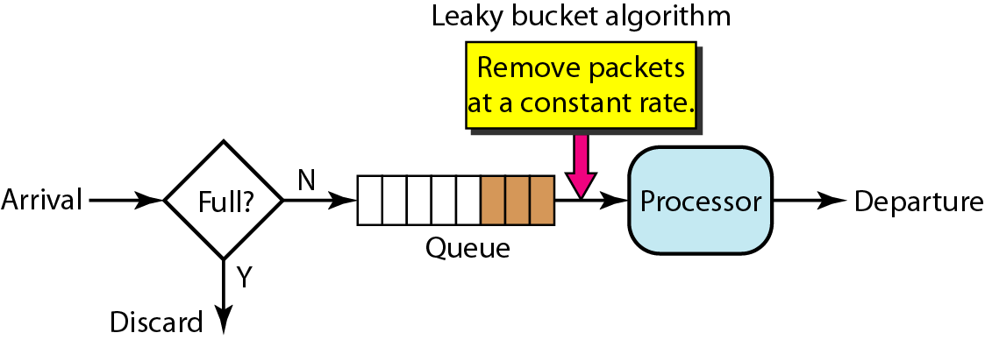
Leaky Bucket Implementation
Algorithm for variable-length packets:
Initialize a counter to n at the tick of the clock
If n is greater than the size of the packet, send packet and decrement the counter by the packet size. Repeat this step until n is smaller than the packet size
Reset the counter and go to step 1

Slide 23
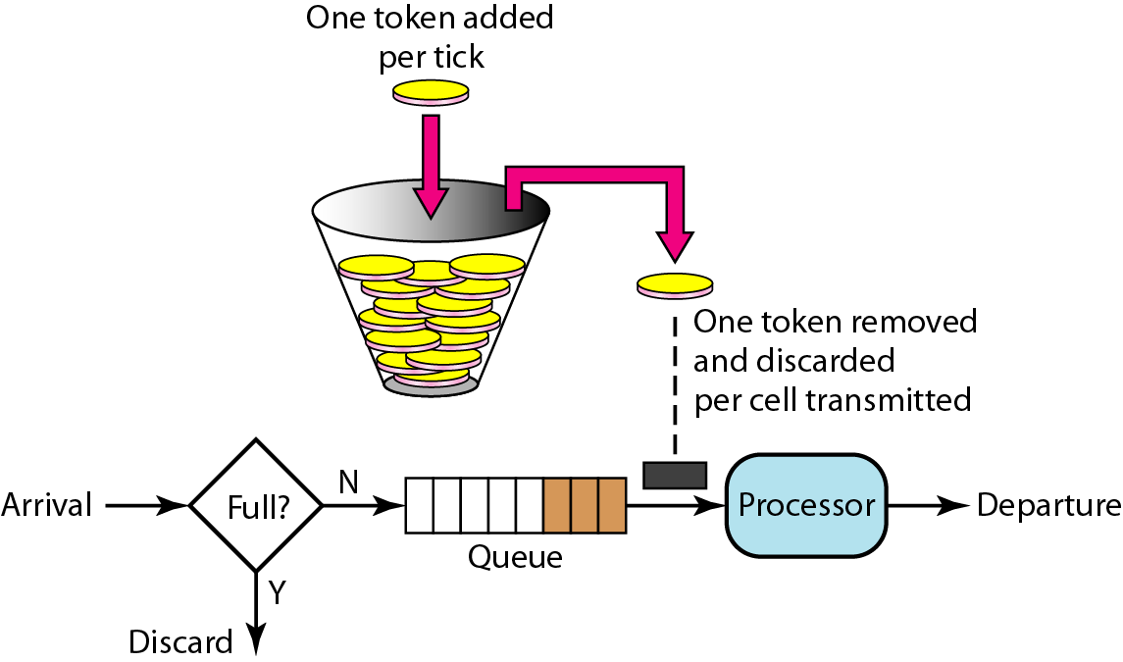
Token Bucket
The token bucket allows bursty traffic at a regulated maximum rate.
Token bucket + leaky bucket: leaky bucket after token bucket

Slide 24
Integrated Services (IntServ)
Integrated Services is a flow-based QoS model designed for IP
Signaling: Resource Reservation Protocol (RSVP)
Flow specification:
Rspec (resource specification) defines the resource that the flow needs to reserve
Tspec (traffic specification) defines the traffic characterization of the flow
Admission: a router decides to admit or deny the flow specification
Service classes: guaranteed service and controlled-load service
Guaranteed service class: guaranteed minimum end-to-end delay
Controlled-load service class: accept some delays, but is sensitive to an overloaded network and to the danger of losing packets

Slide 25
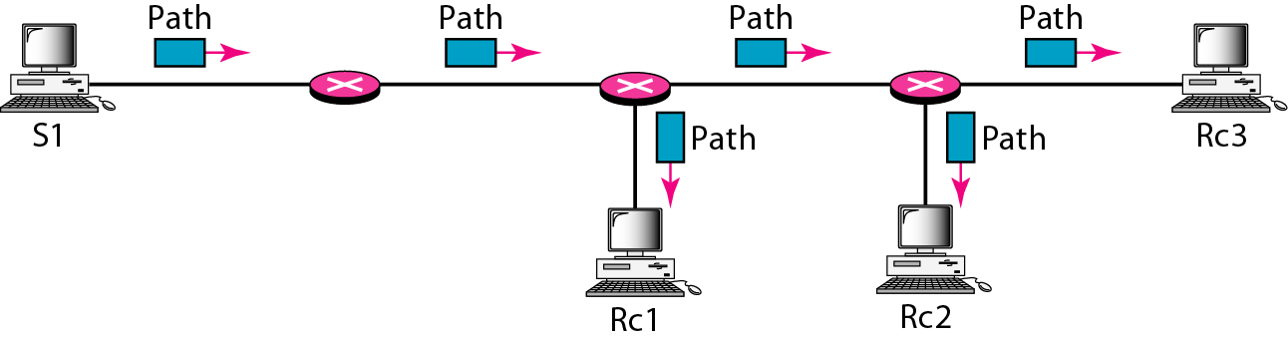
RSVP
In IntServ, the resource reservation is for a flow, a kind of virtual circuit network out of the IP
RSVP is a signaling protocol to help IP create a flow and consequently make a resource reservation
RSVP is a signaling system designed for multicasting
Receiver-based reservation
RSVP message: Path and Resv
Path message: from sender to all receivers

Slide 26
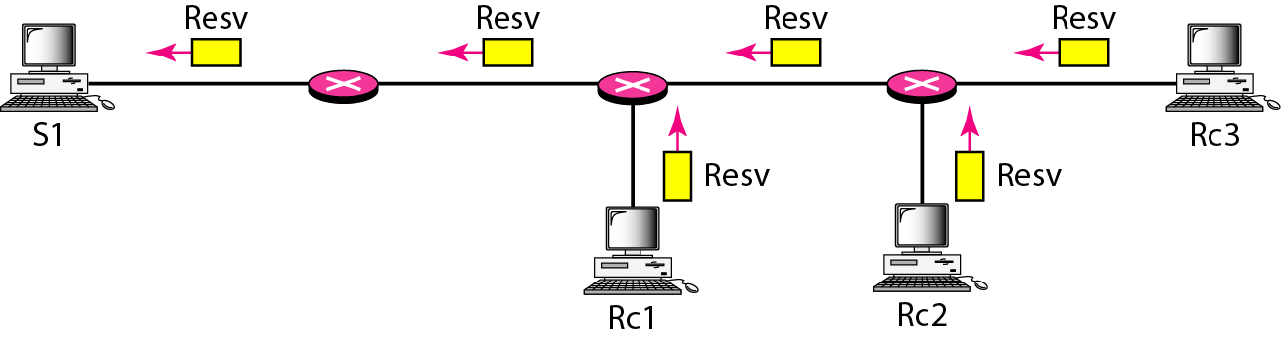
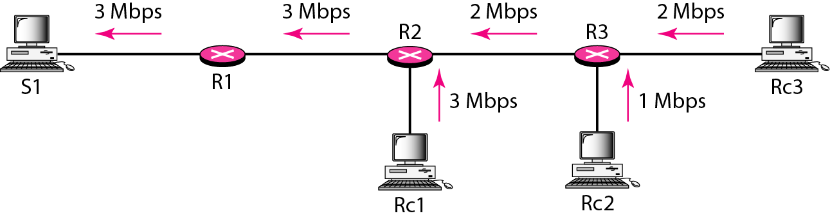
Resv Messages
Make a resource reservation from each receiver to sender
Reservation Merging

Slide 27
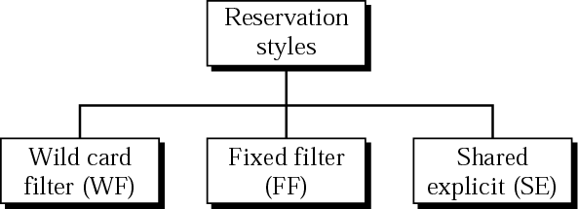
Reservation Styles
Wild card filter style: a single reservation for all senders
Fixed filter style: a distinct reservation for each flow
Shared explicit style: a single reservation which can be shared by a set of flow
Soft state instead of hard state (such as ATM, Frame Relay)
Reservation information to be refreshed periodically
IntServ problem: scalability and service-type limitation

Slide 28

Differentiated Service (Diffserv)
Differentiated Services is a class-based QoS model designed for IP.
Diffserv handles the shortcomings of IntServ
Main differences between Diffserv and Intserv
Main processing is moved from the core to the edge (scalability)
The per-flow is changed to per-class flow service (service-type limitation)
DS field
DSCP (DS Code Point) is a 6-bit field that define per-hop behavior (PHB)
CU (currently unused) is 2-bit

Slide 29
Per-hop Behavior (PHB)
Diffserv defines three PHBs
DE PHB (default PHB) is the same as best-effort delivery
EF PHB (expedited forwarding PHB) provides the following services:
Low loss, low latency, ensured bandwidth
AF PHB (assured forwarding PHB) delivers the packet with a high assurance as long as the class traffic does not exceed the traffic profile of the node

Slide 30
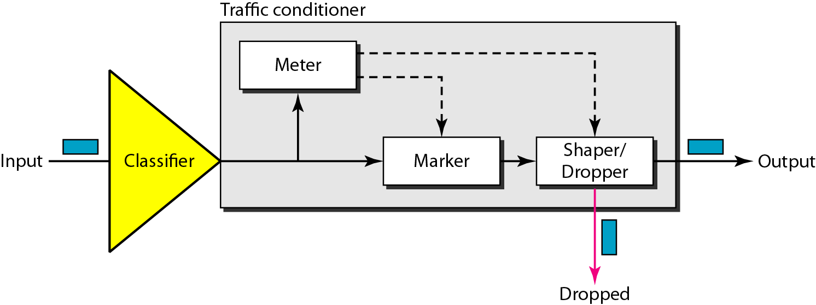
Traffic Conditioner
Meter checks to see if the incoming flow matches the negotiated traffic profile
Marker can re-mark a packet with best-effort delivery or down-mark a packet based on the meter information; no up-mark
Shaper use the meter information to reshape the traffic if not compliant with the negotiated profile.
Dropper, like a shaper with no buffer, discard packets if the flow severely violates the profile

Slide 31
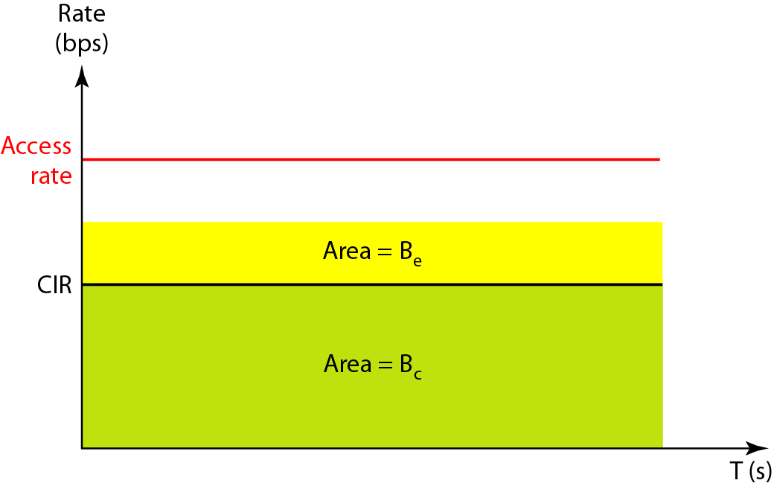
QoS in Switched Network
QoS in Frame Relay
Four different attributes are used to control traffic
Access rate, committed burst size (Bc), committed information rate (CIR), and excess burst size (Be)
Committed Information Rate (CIR) = B_{c}/T bps

Slide 32
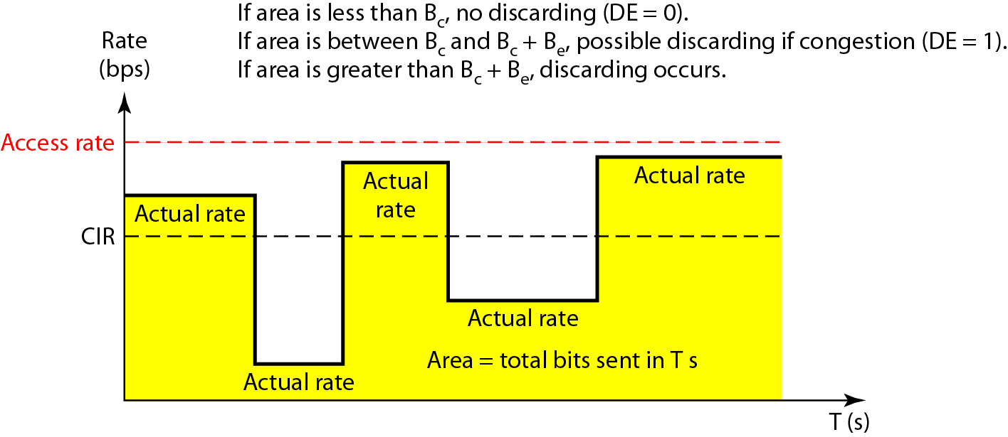
User Rate in Relation to Bc and Bc + Be
How can a user send bursty data ?

Slide 33
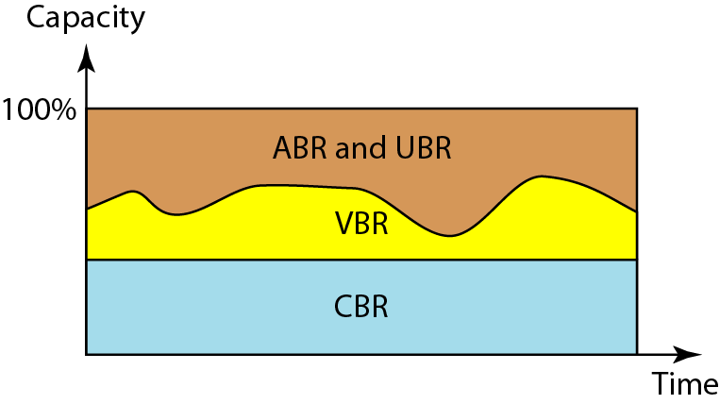
QoS in ATM
QoS in ATM is based on the class, user related attributes, and network-related attributes
Classes: CBR, VBR, ABR, and UBR
CBR (constant): real-time audio or video over dedicated T-line
VBR (variable): compressed audio or video, VBR-RT, VBR-NRT
ABR (available): bursty application
UBR (unspecified): best-effort delivery

Slide 34
QoS in ATM
User-related attributes:
SCR (sustained cell rate): average cell rate over a long time interval
PCR (peak cell rate)
MCR (minimum cell rate)
CVDT (cell variation delay tolerance)
Network-related attributes:
CLR (cell loss ratio)
CTD (cell transfer delay)
CDV (cell delay variation)
CER (cell error ratio)

